Slide 1

THE COFFEE
RENAISSANCE
Where fashion meets the perfect cup
$495B
Global Coffee Market 2025

Slide 2
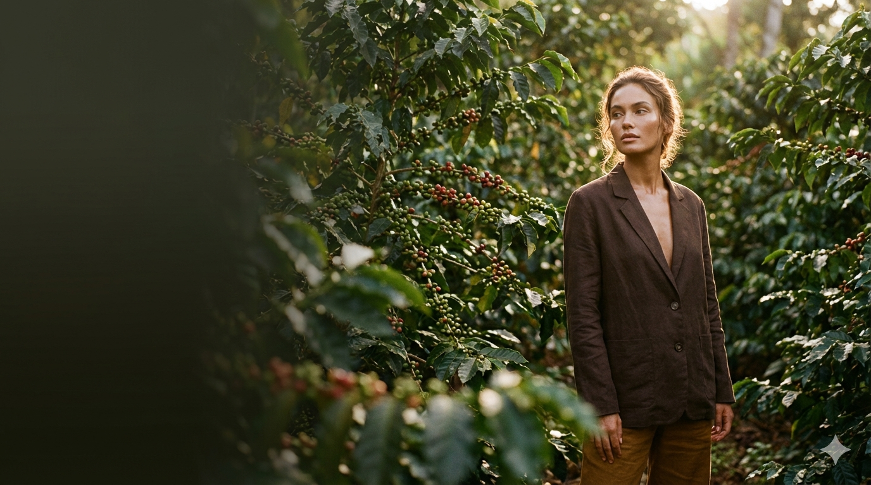
ORIGINS & TERROIR
The birthplace. Wild arabica forests, floral & fruity notes, 1,800m+ elevation.
From highland farms to your morning ritual
Ethiopia
Colombia
Volcanic soil perfection. Balanced sweetness, caramel undertones, shade-grown.
Japan
Precision culture. Pour-over mastery, kissaten tradition, third-wave innovation.
Italy
The espresso architects. Pressure, temperature, crema — elevated to art form.

Slide 3
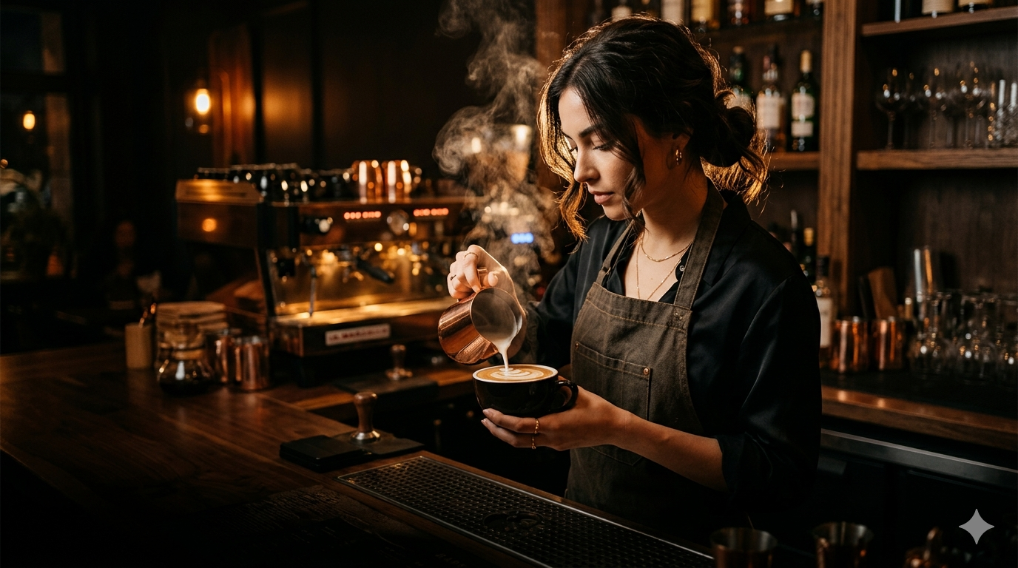
THE PERFECT BREW
Precision, patience, passion — every variable matters
Espresso
The concentrated soul
9 bars • 25 sec • 93°C
Pour-Over
Clarity revealed
Spiral pour • 3 min • 96°C
Cold Brew
Smooth & sweet
12-hour steep • Coarse grind
French Press
Bold & rich
Full immersion • 4 min • 95°C

Slide 4

COFFEE CULTURE
More than a drink — a global lifestyle movement
2.25B
3rd Wave
cups consumed daily worldwide
craft coffee movement
$6.70
12 min
average specialty latte price
average café dwell time

Slide 5

Every Cup Tells a Story
Ritual • Craft • Connection
// the coffee renaissance | 2025

